Slide 1
Azure Functions
Baltomsdn 3/21/2018
Notes:
https://docs.microsoft.com/en-us/azure/azure-functions/

Slide 2
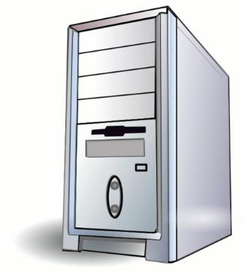
A Brief History of “THE CLOUD”
Notes:
Tower under Ed’s desk or in a closet

Slide 3
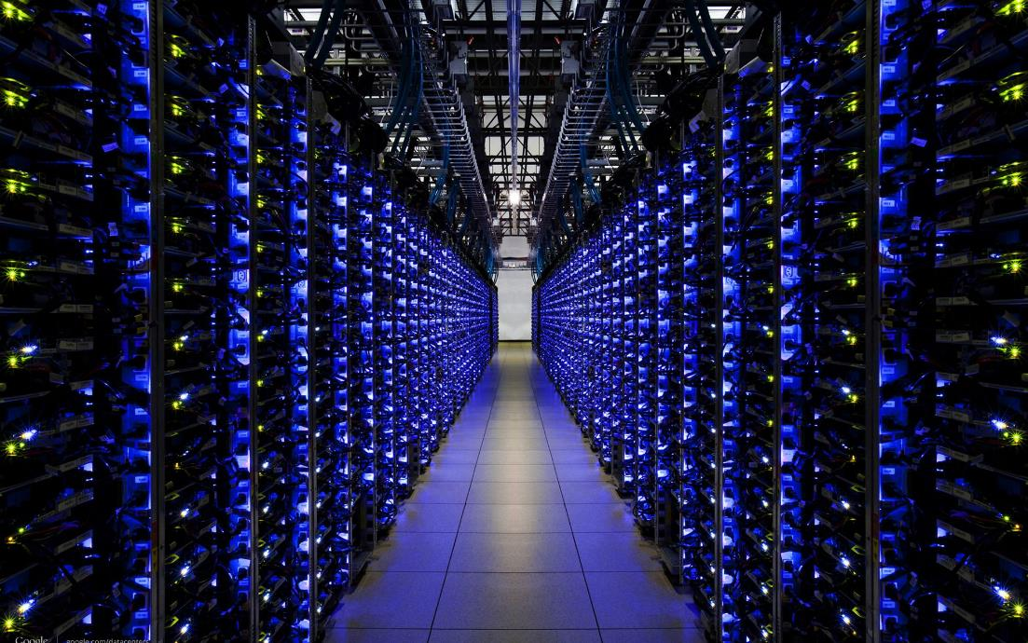
Notes:
Colocation facility
Physical PCs in data center
VMs in a data center

Slide 4
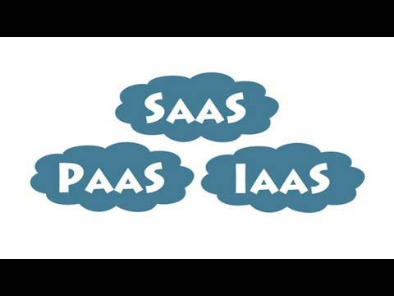

Slide 5


Slide 6

Serverless (FaaS*) (* - I kind of hate the “<anything> as a service” trend but I think it’s here to stay ☹)
Notes:
FaaS = serverless compute (contrast with Cosmos DB which is serverless DB)
Billing like a utility

Slide 7
Serverless? Really? Ummm, no…
“Serverless is to servers as wireless is to wires”
-unknown
Notes:
After all, it’s just someone else’s servers…

Slide 8
Azure Function App
A single function app can host multiple functions
Consumption plan or app service plan
Windows or Linux hosts (Linux only supports app service plan)
Use C#, F#, JavaScript, Java, or custom (mix & match is supported)
Develop in Azure Portal, Visual Studio, CLI (VS Code)
Multiple triggers:
HTTPTrigger, TimerTrigger, GitHub webhook, Generic webhook, CosmosDBTrigger, BlobTrigger, QueueTrigger, EventHubTrigger, ServiceBusQueueTrigger, ServiceBusTopicTrigger
Multiple deployment options:
VSTS, OneDrive, Local Git Repo, GitHub, BitBucket, Dropbox, External Repo
Docker image of runtime host is available (run Azure Functions on another cloud provider or on prem)
Azure Functions Runtime can be deployed on Windows Server 2016 or Windows 10 Creators Update

Slide 9
Costs
App Service Plan
Same as a regular App Service
Pay per hour per host
Serverless in the sense of PaaS
You are responsible for scaling up/out
Consumption Plan
Cost = executions + (elapsed time * memory consumed)
Time rounded up to nearest millisecond
Memory rounded up to nearest 128MB
Multiply to get GB-s
Scales automagically
Per function execution time limit
No charge when used with Azure IoT Edge
Notes:
https://docs.microsoft.com/en-us/azure/azure-functions/functions-scale
https://azure.microsoft.com/en-us/pricing/details/functions/
S1 App Service host (1 core, 1.75Gb RAM) is 0.10/hr (~$75/month)
Linux is only App Service Plan
Consumption plan default timeout is 5 minutes (can be increased to 10)

Slide 10
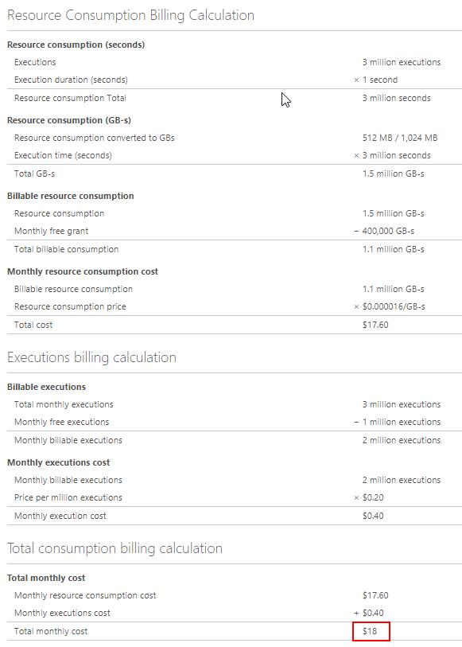
Notes:
A function with
observed memory consumption of 512 MB
executes 3,000,000 times during the month
has an execution duration of one second
Storage account costs are not included (code actually lives in a storage account)

Slide 11
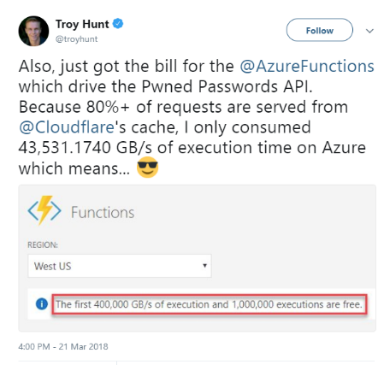

Slide 12
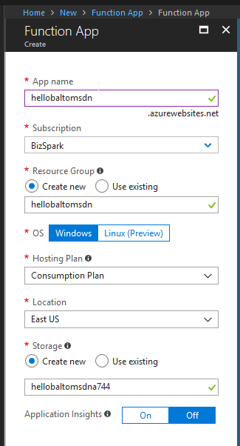
Notes:
http://bit.ly/hellobaltomsdn

Slide 13
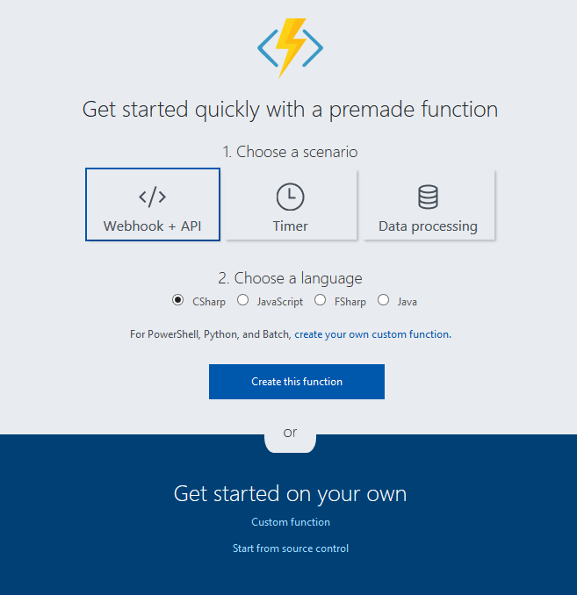

Slide 14
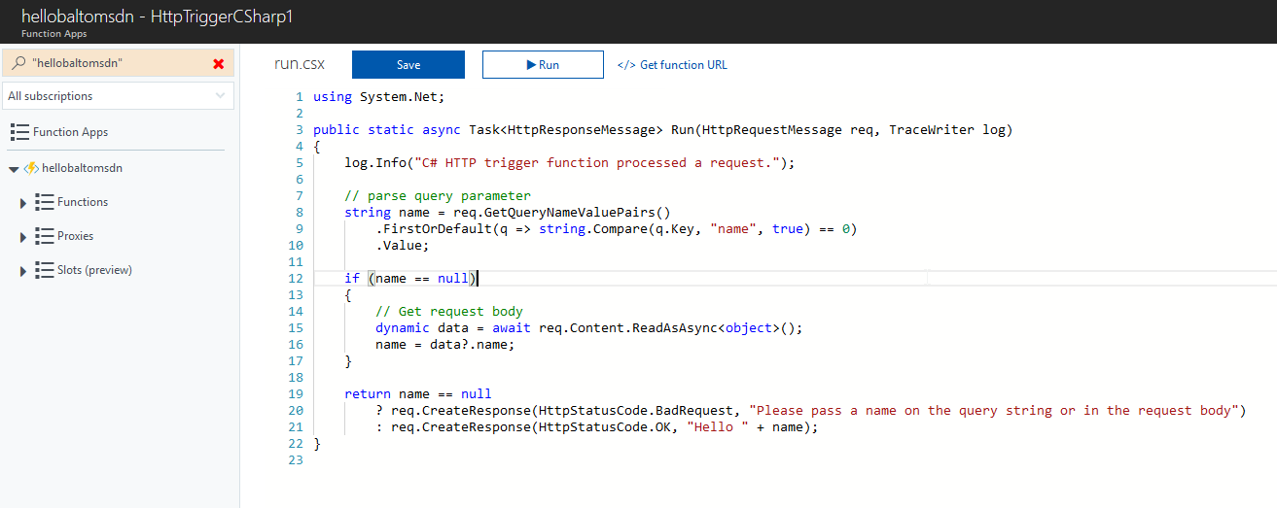

Slide 15
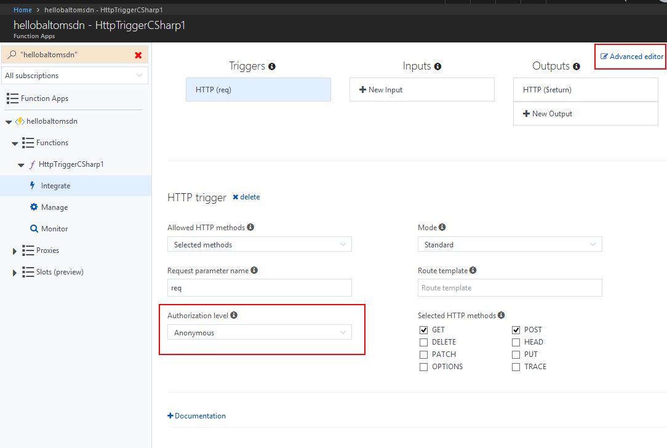

Slide 16
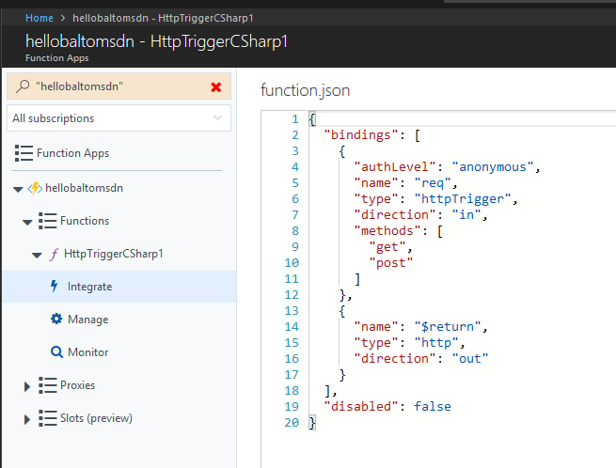

Slide 17
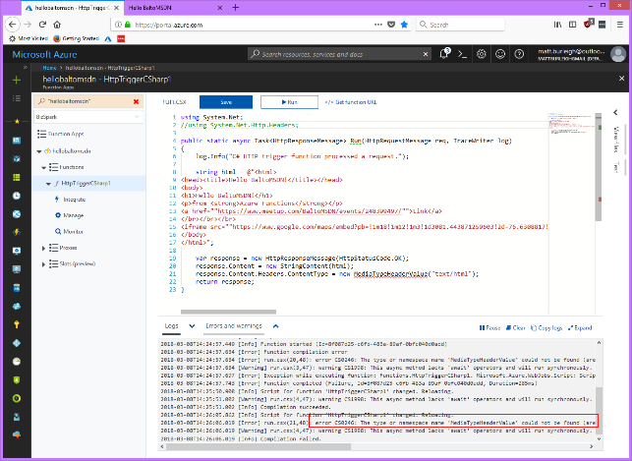

Slide 18
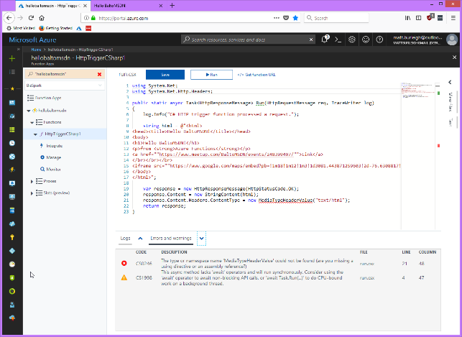

Slide 19
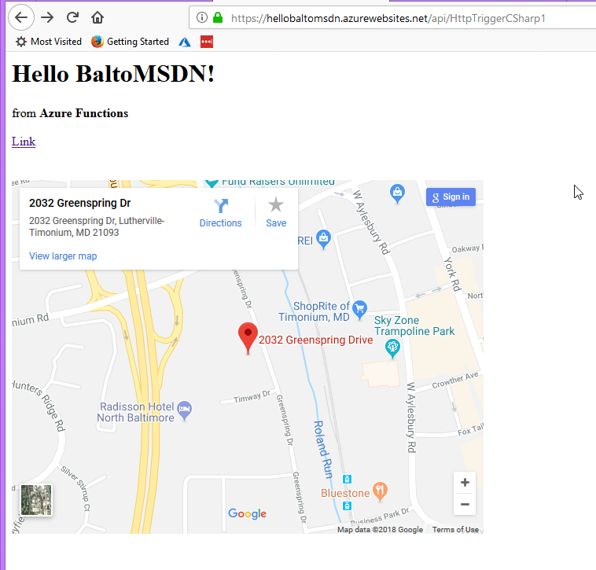
http://bit.ly/hellobaltomsdn
Notes:
http://bit.ly/hellobaltomsdn

Slide 20
Load Test Demo
http://bit.ly/loadtestbaltomsdn
Notes:
http://bit.ly/loadtestbaltomsdn

Slide 21
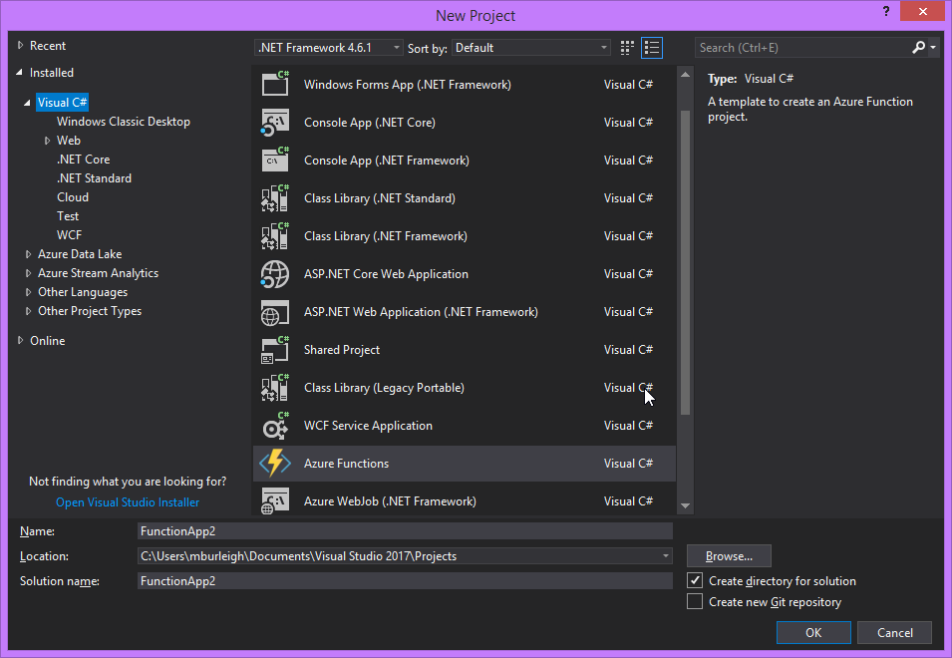
Visual Studio 2017
Notes:
Requires “Azure Functions and Web Job Tools” extension

Slide 22
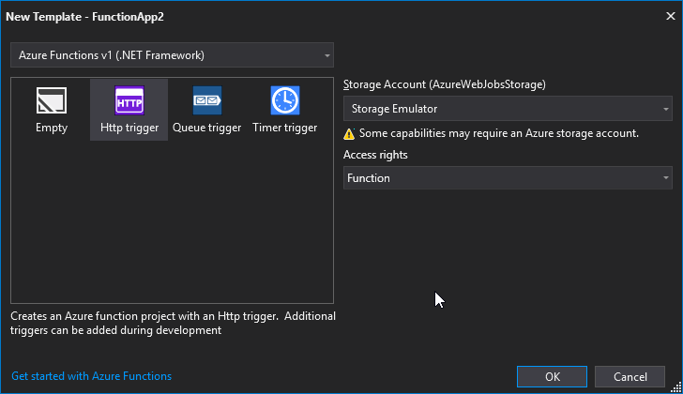

Slide 23
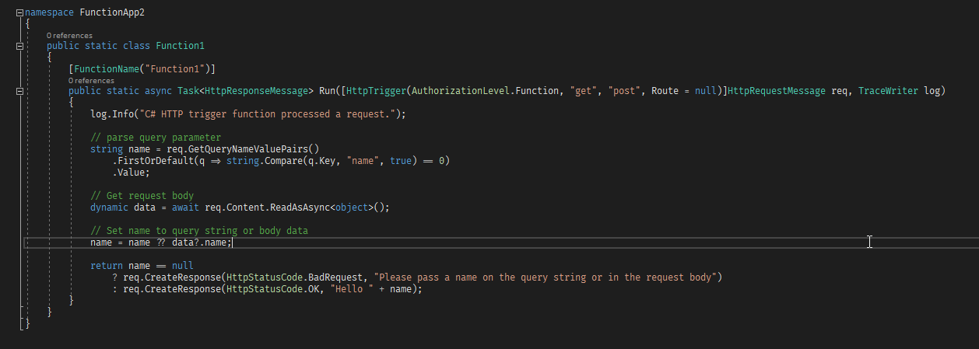
Notes:
Note FunctionName attribute (becomes url segment)

Slide 24
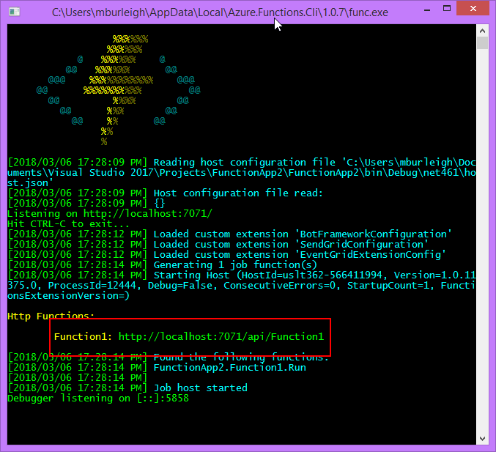
Notes:
Note /api segment (like WebApi endpoints)

Slide 25
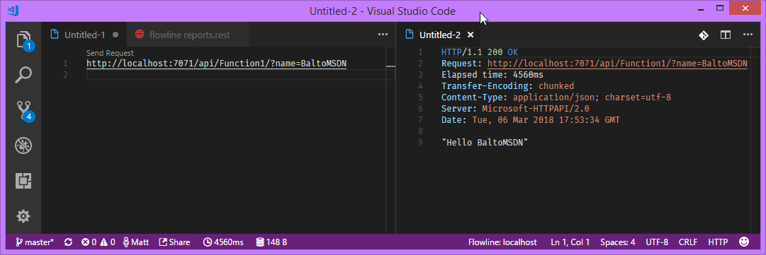

Slide 26
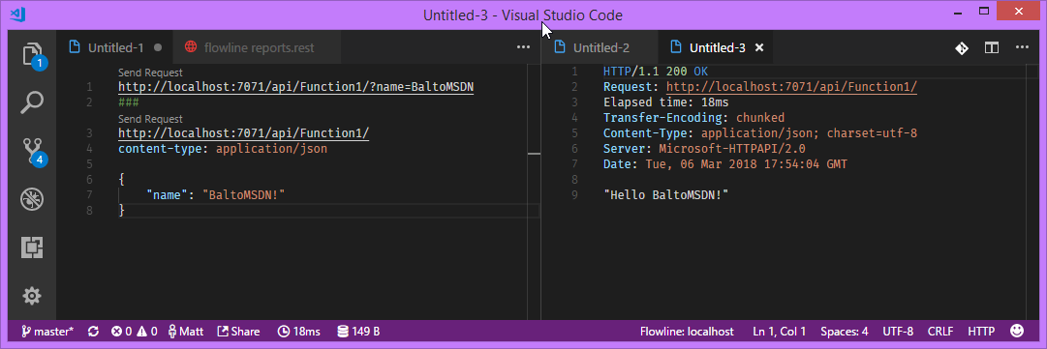

Slide 27
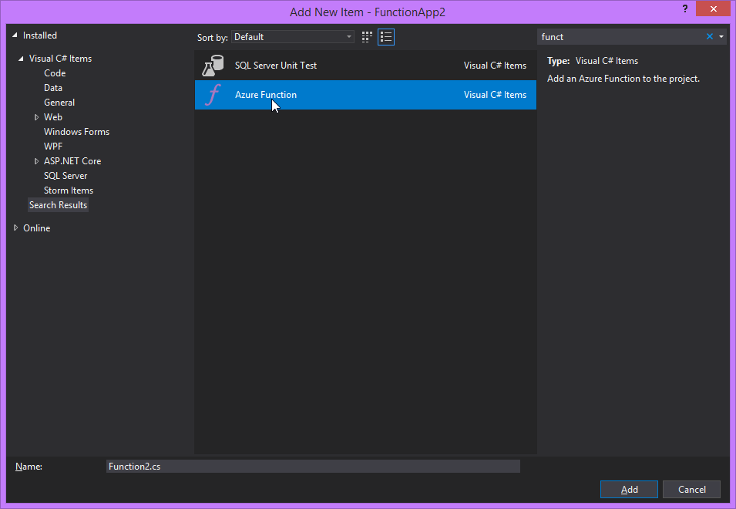
Notes:
Can control granularity by functions per project & # of projects

Slide 28
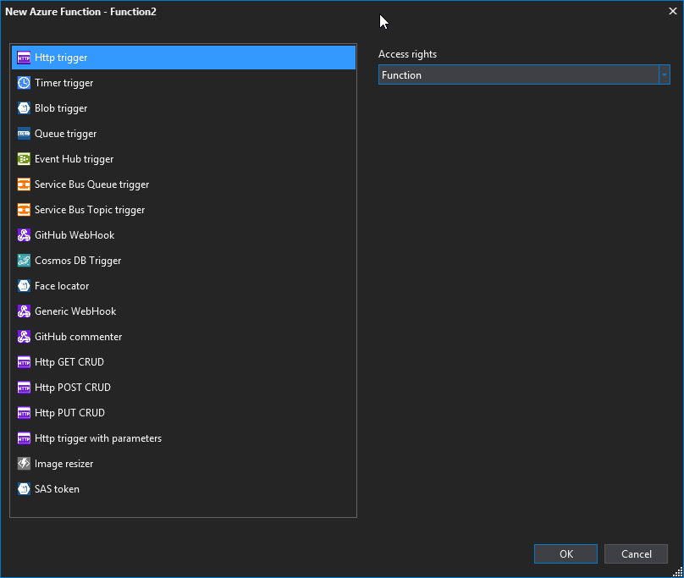

Slide 29
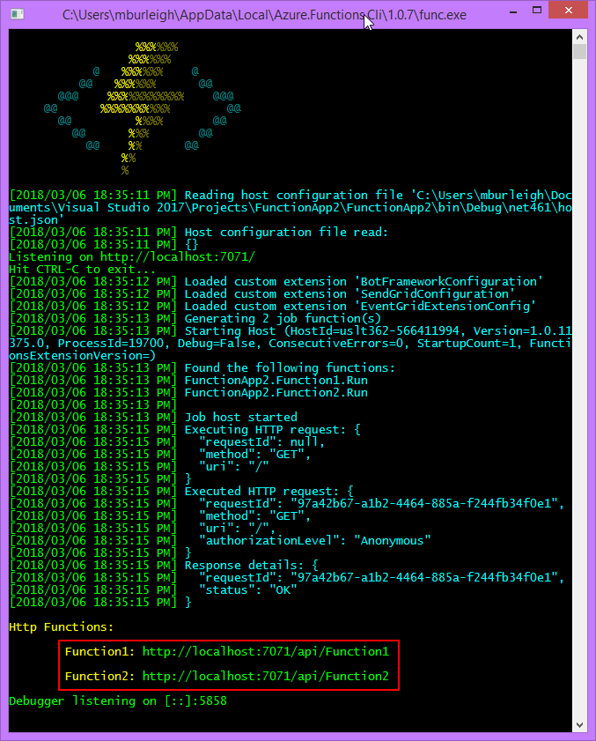

Slide 30
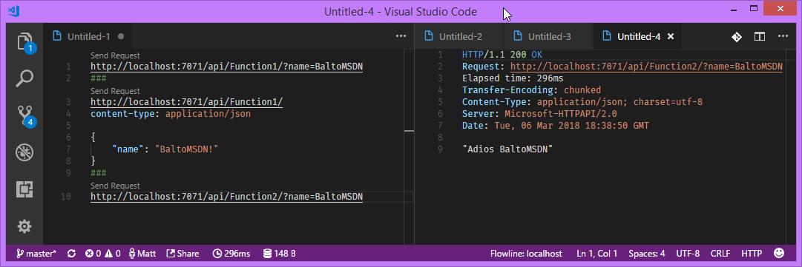

Slide 31
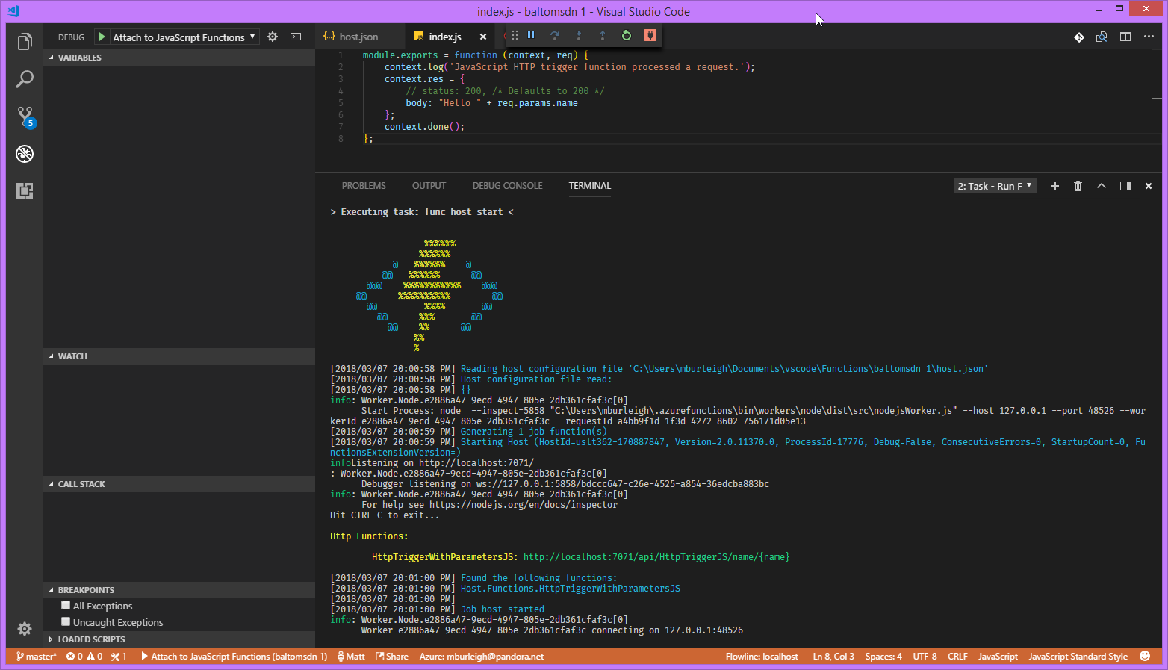
Notes:
Example of passing params as url segments

Slide 32
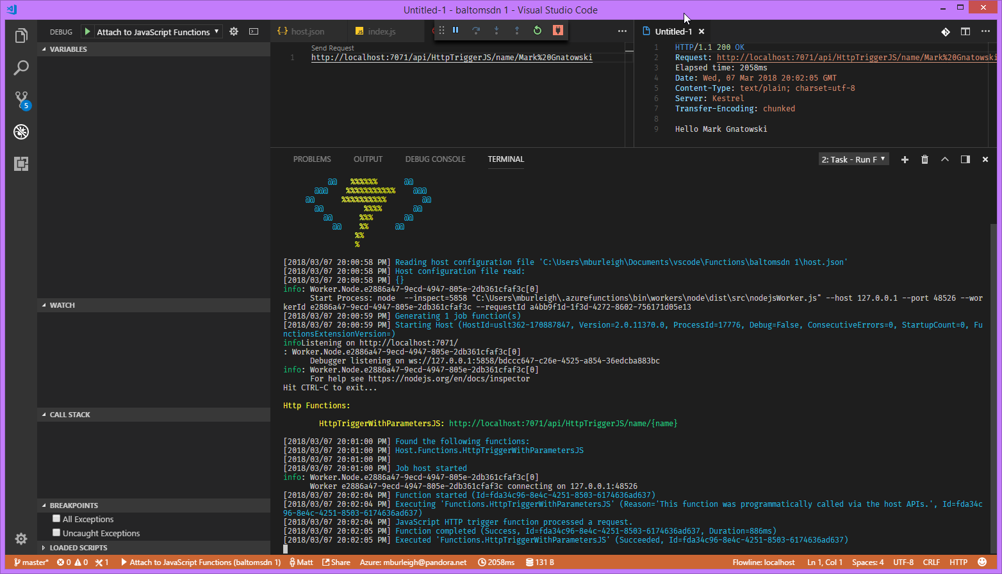

Slide 33
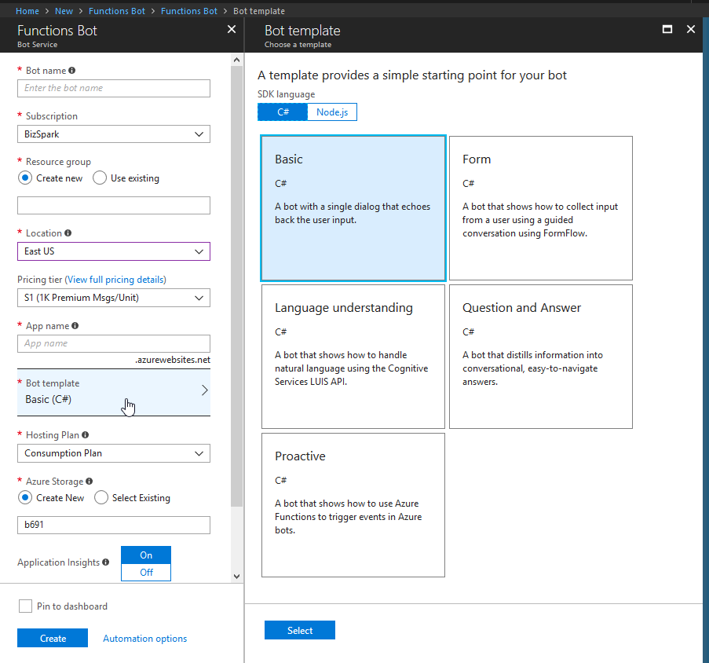
Functions Bot

Slide 34
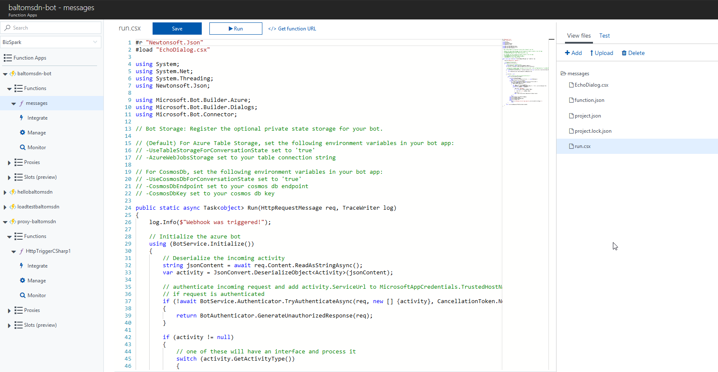

Slide 35
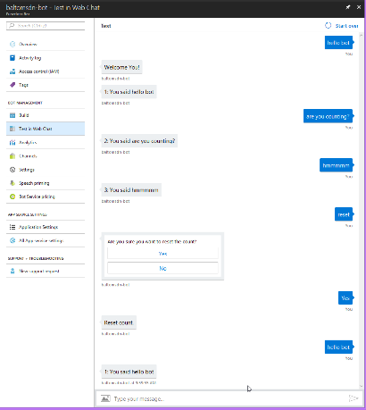

Slide 36
Durable Functions
Define workflows in code
Can call other functions synchronously & asynchronously
Output saved to local variables
Automatic checkpoints
Local state is not lost if process recycles or VM reboots
Patterns
Function chaining
Fan-out/fan-in (MapReduce)
Async HTTP APIs (long running external operations)
Monitoring
Human interaction
Reliable execution
Queues
Checkpointing to storage (event sourcing)
Orchestrator
Deterministic (& idempotent)
Non-blocking
Initiate async only via DurableOrchestrationContext class
No infinite loops
Notes:
Overcome the timeout limitations of functions
https://docs.microsoft.com/en-us/azure/azure-functions/durable-functions-overview

Slide 37
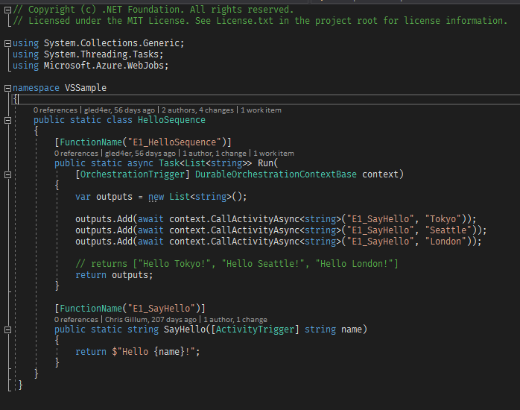
Notes:
https://github.com/Azure/azure-functions-durable-extension
https://docs.microsoft.com/en-us/azure/azure-functions/durable-functions-sequence

Slide 38
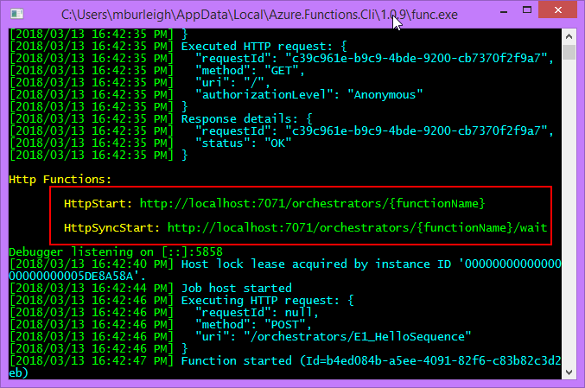

Slide 39
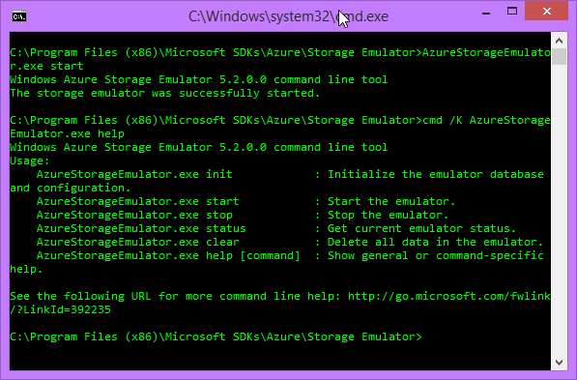

Slide 40
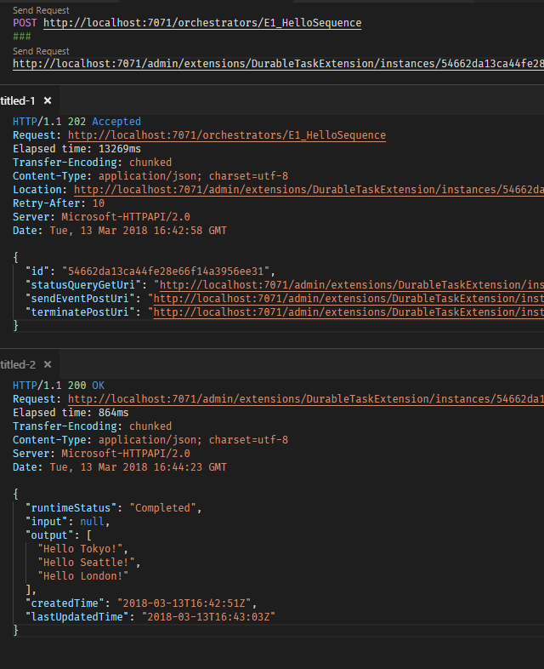

Slide 41
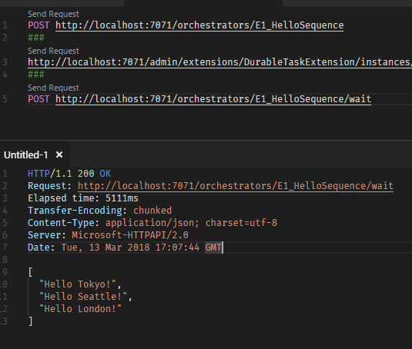

Slide 42
Azure Functions Proxies
Lightweight reverse proxy built into a function app
Not a substitute for APIM
Full control over API surface
Ability to modify request/responses
Notes:
https://docs.microsoft.com/en-us/azure/azure-functions/functions-proxies

Slide 43
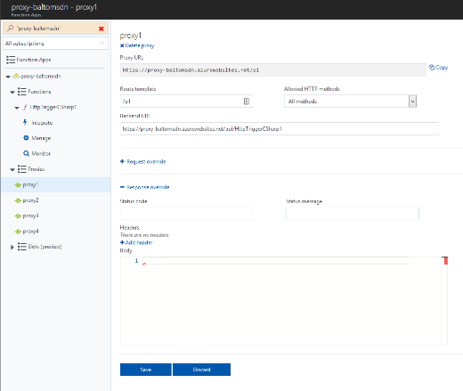

Slide 44
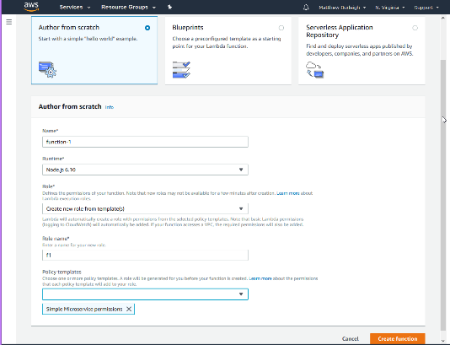
AWS Lambda
Notes:
https://aws.amazon.com/lambda/
Released 11/2014

Slide 45
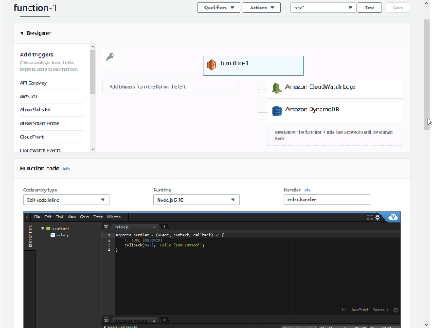

Slide 46
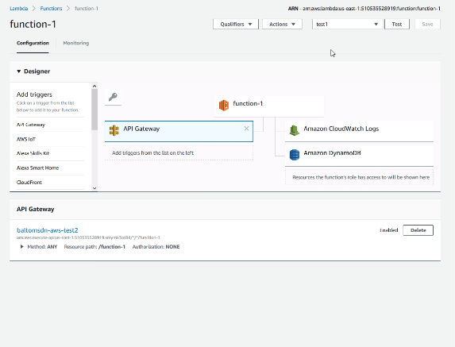

Slide 47
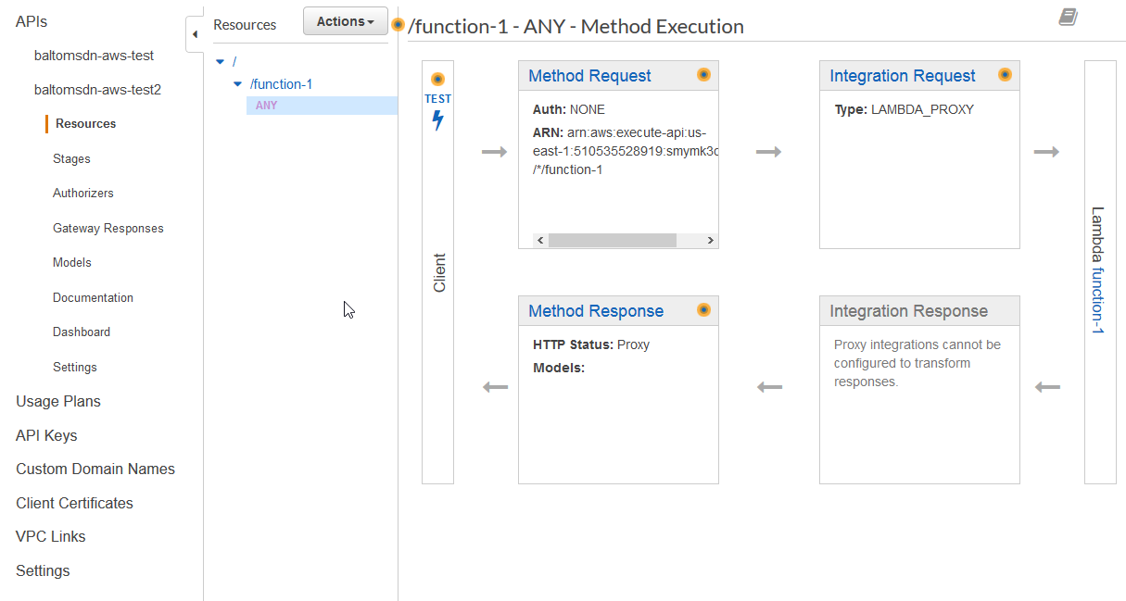

Slide 48
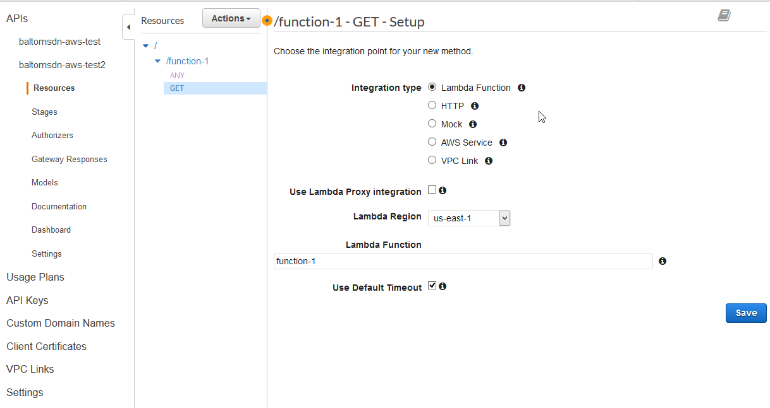

Slide 49
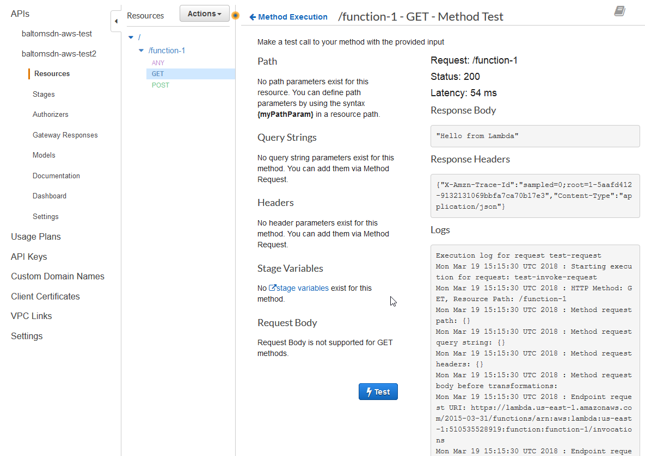

Slide 50
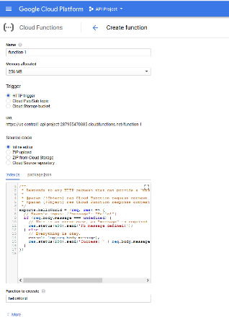
Google Cloud Functions
Notes:
https://cloud.google.com/functions/
Released 2/2016

Slide 51
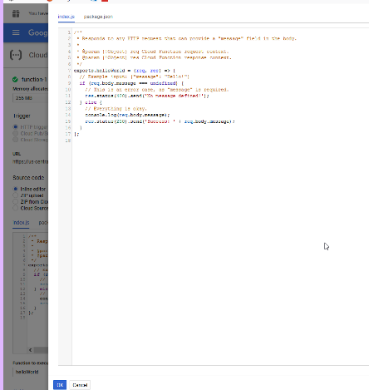

Slide 52
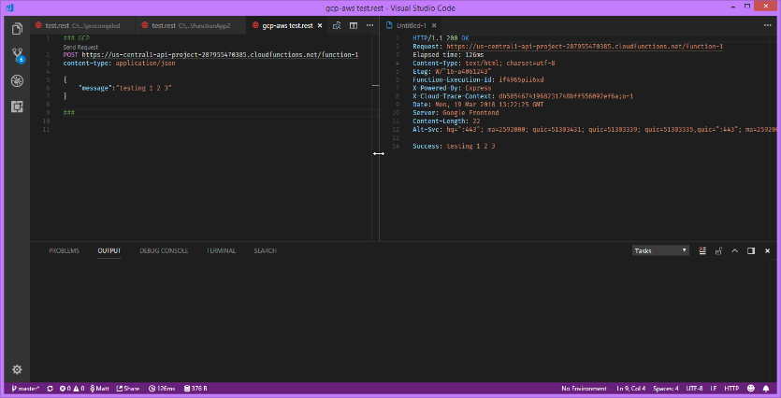

Slide 53
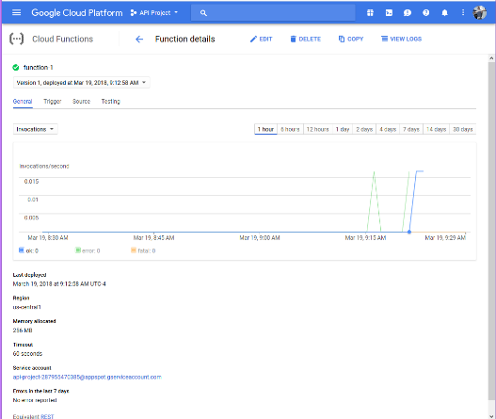

Slide 54
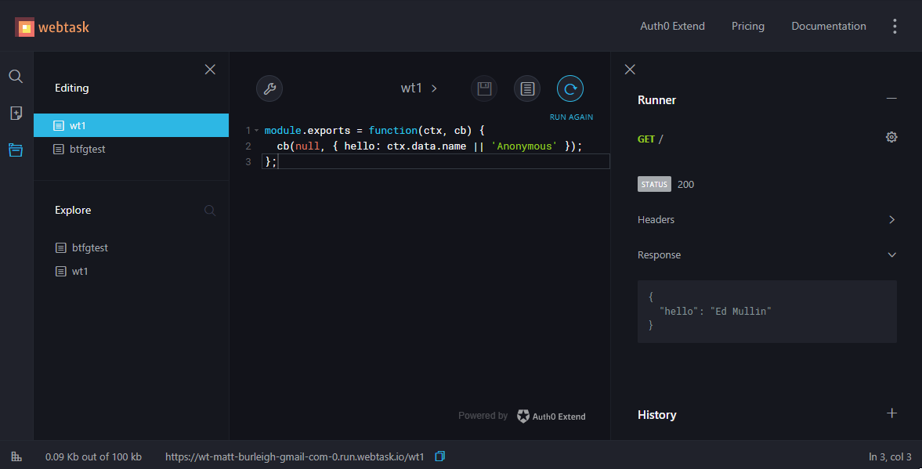
Auth0 Webtask
Notes:
https://webtask.io/
1 request/second for free (upgrade to Auth0 Extend)
CLI also available

Slide 55
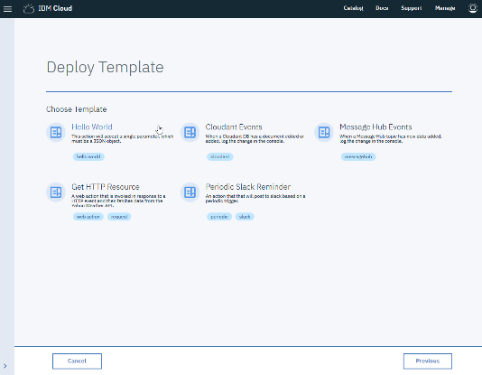
IBM Cloud Functions
Notes:
https://console.bluemix.net/openwhisk/

Slide 56
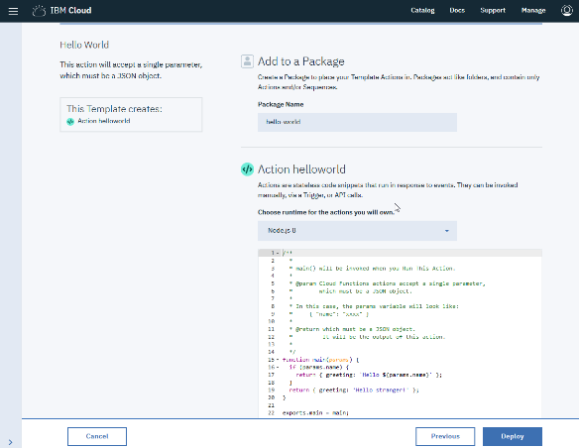

Slide 57
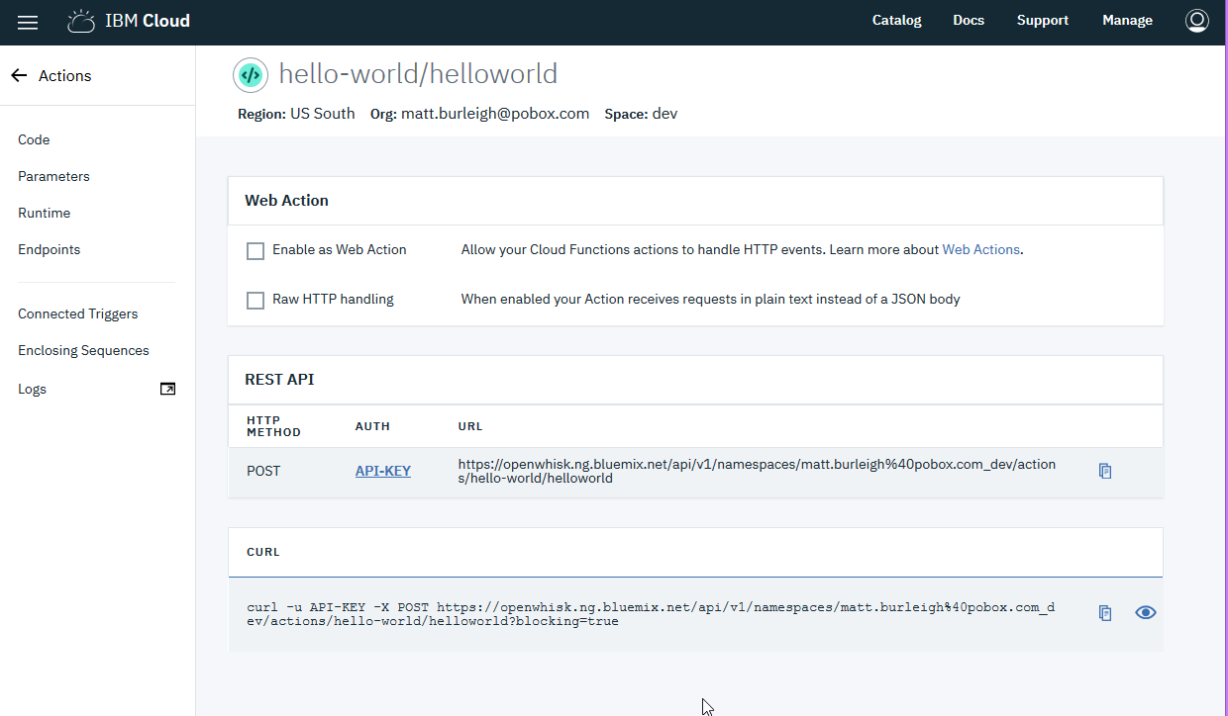

Slide 58
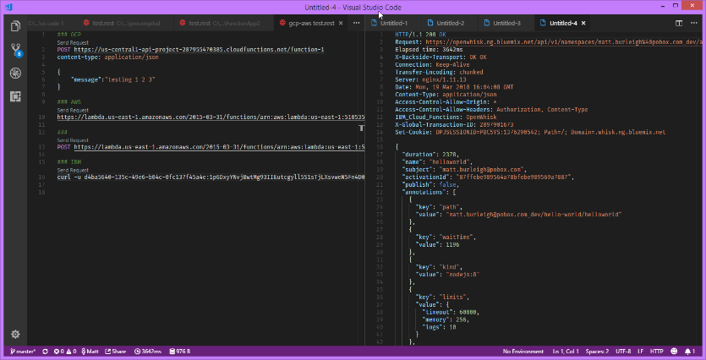

Slide 59
Pros
Limited management/configuration options
Code only
Autoscaling
Max 200 instances (multiple requests per instance)
At most 1 instance allocated per 10 seconds
Pushes towards single responsibility/separation of concerns
Lower cost than IaaS or PaaS (potentially)
Easy to consume
Usually just a REST call
Event triggers make it easy to automate
vs event bus type architectures
Durable functions can be used for workflows & long running operations
Cross platform development

Slide 60
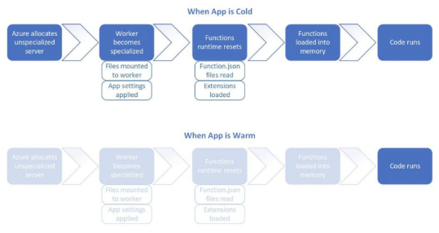
Cons
Limited management/configuration options
Cold start delay
Endpoint sprawl
Stateless
Limited running time
Limited
Increased logging fragmentation
Diagnostics can be difficult

Slide 61
Resources
https://thepowerofserverless.info/
https://docs.microsoft.com/en-us/sandbox/functions-recipes/
Azure Serverless Computing Cookbook
https://github.com/Azure/Azure-Functions/wiki/Samples-and-content
https://www.azurefromthetrenches.com/azure-functions-significant-improvements-in-http-trigger-scaling/

Slide 62
Questions?
Matt Burleigh
Email: mburleigh@pandora.net
Twitter: @svdreamline

Slide 63
Thanks!

